Slide 1
CHARITY MISSIONARY BAPTIST CHURCH BIBLE STUDY WEDNESDAY, NOVEMBER 1, 2023 “CHANGE YOUR ATTITUDE!” READ: MATTHEW 5:1-12
Led by:
Led by Rev. Nelson B. Rivers, III

Slide 2
1. Where in the Bible do we find the first recorded sermon by Jesus and what is it called?

Slide 3
ANSWER
The Sermon on the Mount which is found in Matthew 5:1-12 and Luke 6:20-23 and it is called the Beatitudes.

Slide 4
2. This sermon by Jesus is called the Beatitudes. What does the word beatitude mean why is the meaning so important to understanding this text and the sermon?

Slide 5
ANSWER
The word "beatitude" is Latin and it means blessed or blessedness. Beatitude is not found in the English Bible. The Beatitudes do not describe separate types of Christian character, but list qualities and experiences that are combined in the ideal Christian character.

Slide 6
ANSWER
In other words, a good Christian attitude is not one characteristic but rather all of these characteristics preached by Jesus are necessary to have a good Christian attitude! How close are you to a good Christian attitude?

Slide 7
3. When you read the Beatitudes in Matthew 5:3-12, do you think any Christian can live up to such high standards?

Slide 8
ANSWER
No Christian can live up to all of these high standards, but we should continue to try! In fact, Jesus begins the Beatitudes by telling us about our inability to live up these standards in mind—Blessed are the poor in spirit, for theirs is the kingdom of heaven. Those acknowledging their spiritual poverty are in the best position to experience God’s blessing and enjoy his kingdom.

Slide 9
ANSWER
Read Ephesians 2:8-10 NLT and realize that our salvation and hope for heaven are rooted firmly in the grace of God. Nevertheless, God’s grace will produce positive, tangible change in our lives when we change our attitudes to be more like the beatitudes.

Slide 10
ANSWER
Even when we try and fail, we’re to keep trying and trusting. The Beatitudes describe the life of blessing God intended for humanity from the beginning. The closer we come to the standards of Jesus, the more we experience the blessing of God.

Slide 11
4. Why do you think Jesus turned our value system upside down in Matthew 5:3–12?

Slide 12
ANSWER
Jesus wanted to change our attitudes and value system of then and now! He wanted to dispute and even destroy the conventional wisdom of that time and now which said the wealthy and influential enjoyed more of God’s blessings. Jesus wanted his followers to see that material things are only temporary and certainly not the only reality.

Slide 13
ANSWER
He didn’t want them to think of their current situations as signs of God’s blessing or judgment. Instead, he wanted them to see that the poor can be spiritually wealthy, read James 2:5!

Slide 14
5. What do you think Jesus is teaching us in Verse 4 about being in mourning ourselves and comforting those among us who are going through mourning right now?

Slide 15
ANSWER
It means both. This beatitude is for those who are mourning over personal loss among family and friends or just what is going in the world like in Palestine and Israel. Then and now, Israel and Palestine were going through the results of the sins of injustice and bigotry! Just like today! Jesus was teaching then and teaches us now, that like all other human beings Christians will have heartbreak, death, and sickness but unlike the rest of the world our attitude must be that “even in this God is able to wipe away our tears.”

Slide 16
ANSWER
This also tells us that grief and mourning are inevitable especially among Christians and we must know that we will be comforted by God’s word, the example of Jesus and his earthly representative, the church. Jesus expects and commands us to comfort those who are going through mourning and loss with prayer, presence, and action.

Slide 17
6. What attitude is Jesus teaching us in Verse 6, in the NLT, that we can use today to develop an attitude of fighting against injustice and encouraging an attitude being hungry for justice?

Slide 18
ANSWER
This beatitude is a reassuring command to saying that Christians should thirst for justice like those who are thirsty for water in hot weather, and we must be hungry for justice like those who have not had food for days! Jesus is literally commanding us to work for justice with the knowledge that our work hunger and thirst will be “satisfied.”

Slide 19
ANSWER
Which I believe his reassurance that his words in Luke 4:18 that he came to set the oppressed free and his church should have the same commitment. A hunger and thirst for justice!

Slide 20
7. Read Verse 9 in the NIV or NKJV and tell us what you think is the difference between peacemakers and peacekeepers?

Slide 21
ANSWER
It is important to make the distinction between peacemakers and peacekeepers. Peacemakers are those work to make peace. Peacekeepers, like police officers or an occupying army, keep the peace after peacemakers make peace! Peacemakers are not police or an occupying army. Jesus was teaching his disciples then and us now to work for peace.

Slide 22
ANSWER
And this work will always require action beyond just praying. In Charleston and Berkeley County right now we are working for peace by opposing injustice and attacks on our children. There can no peacekeepers until there are peacemakers!

Slide 23
ANSWER
Peace is not the absence of noise but the presence of justice. Just because we are quiet does not mean we have peace!

Slide 24
8. Read Verses 10-12 and tell us how or why should any Christian “be glad” to be persecuted, insulted, mocked and lied on?

Slide 25
ANSWER
While this seems illogical and even a conflicting beatitude, it comes after the peacemakers because Jesus was saying if you fight for justice or against unrighteousness or against oppression you should feel blessed when you are attacked or persecuted for standing up for justice (which is the meaning of righteousness)…

Slide 26
ANSWER
because that means you are doing the right thing! Verse 10 is saying if you stand for Jesus against oppression and injustice and mistreatment by the powerful, you are doing it for his sake and you will be attacked.

Slide 27
ANSWER
When Jesus gives us the prophets as an example in Verse 12, we must sit up and pay attention! Be glad because you must do what the prophets like Isaiah, Jeremiah, and Ezekiel he was telling us to be happy and very glad because like the prophets of old today we should be trying to get in “Good trouble!” And be glad about it!!

Slide 28
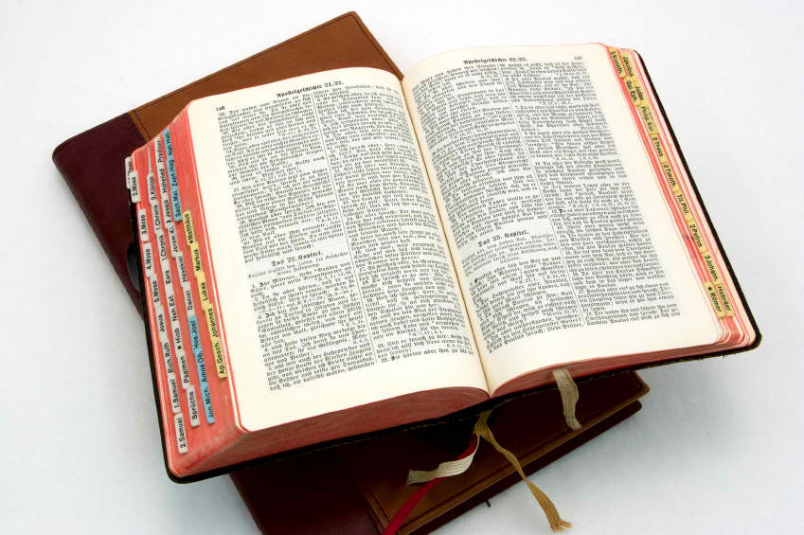
UNTIL NEXT TIME!!!

