Slide 1
CHARITY MISSIONARY BAPTIST CHURCH BIBLE STUDY – WEDNESDAY, DECEMBER 6, 2023 “THE BIRTH OF THE SAVIOR” MATTHEW 1-2
Led by:
Led by Pastor Nelson B. Rivers, III

Slide 2
1. Why did Matthew give the genealogy of Jesus in Matthew 1:1?

Slide 3
ANSWER
Matthew wanted to underscore Jesus’ human birth into a family with traceable roots. A Jewish male always traced his lineage through his father—and Joseph was Jesus’ legal father.

Slide 4
ANSWER
The genealogy also introduces a major theme in this book: Since he was considered a descendant of both David and Abraham, Jesus became the fulfillment of prophecies and covenants God had made with them.

Slide 5
2. What’s the significance of calling Jesus the Christ in Matthew 1:16?

Slide 6
ANSWER
Although we often think of the word Christ as a name, it is actually a title. Christ is a transliteration of the Greek word for the Hebrew title Messiah. Both terms mean the Anointed One and refer to the special one sent and ordained by God to save his people. See Who is the Anointed One? Psalm 2:2).

Slide 7
3. What’s so special about the number fourteen in Matthew 1:17?

Slide 8
ANSWER
Perhaps Matthew used it because it is a multiple of seven—a number that symbolized completeness. He skipped over some generations in order to achieve this literary order.

Slide 9
4. Why was divorce necessary when Joseph and Mary were only engaged in Matthew 1:19?

Slide 10
ANSWER
His wife-to-be was pregnant, and her child wasn’t his—a disgrace in any era! Unlike today, first-century engagements were binding premarital contracts leading to marriage. During the year of engagement, the couple behaved like husband and wife (except that they did not live together or have sex). To break off such an engagement, a divorce was required.

Slide 11
5. Why was it necessary for Mary to have a virgin birth in Matthew 1:23?

Slide 12
ANSWER
Some think it was because Adam’s original sin has been passed down to humanity through sinful parents. They say Jesus, to be free of sin, needed to circumvent the natural method and be conceived in a supernatural way. Others think Jesus’ birth, a miraculous birth to a sexually pure young woman, served to underscore his supernatural beginning—a sign of his divinity.

Slide 13
6. Who was King Herod?

Slide 14
ANSWER
Herod the Great reigned over Judea from 37 to 4 B.C. as a bloodthirsty tyrant who murdered, among others, his wife, mother-in-law and three sons, Herod was part Jew and part Gentile. The Roman empire gave Herod his authority to rule the Jews, but most Jews hated him even though he referred to himself as the king of the Jews.

Slide 15
7. Who were the Magi in Matthew 2:1?

Slide 16
ANSWER
Some have suggested that the Magi were a priestly tribe of Medes. Others say they were Persian elders from Babylon, schooled in philosophy, medicine and science. They may have belonged to the same order of astrologers as those in Daniel’s day (see Daniel 1:20; 2:2; 4:7; 5:7).

Slide 17
8. Why would God give special revelation to astrologers in Matthew 2:2?

Slide 18
ANSWER
These would not be astrologers as we think of them today. In the New Testament, the word Magi can mean two different things: those who study the stars, or sorcerers who practice magical arts. Here we find the first sense: experts of the stars who are searching for wisdom and meaning. The Magi symbolize the non-Jewish world and all who search for ultimate truth. By including this story, Matthew shows that God’s salvation is intended for Jews and Gentiles alike.

Slide 19
9. Why do you think that God warned Joseph but not the other families?

Slide 20
ANSWER
Sometimes God dramatically intervenes in human history, but at other times he allows the consequences of sin to play out. People’s inhumanity toward one another causes much suffering in this world, and though this grieves God, he permits them to make destructive choices. God allowed Herod’s lust for power to run unchecked through Bethlehem, though he protected his Son for the purpose he intended to fulfill.

Slide 21
10.Was Bethlehem, the birthplace of Jesus Christ, in Africa or Palestine?

Slide 22
ANSWER
Both. Bethlehem was in Palestine which was in Africa which made Jesus an African and a Palestinian which is the same as many of us being born Americans and South Carolinians! So, when we put on the tee shirts that say, “Jesus was an African” we are speaking truth!!

Slide 23
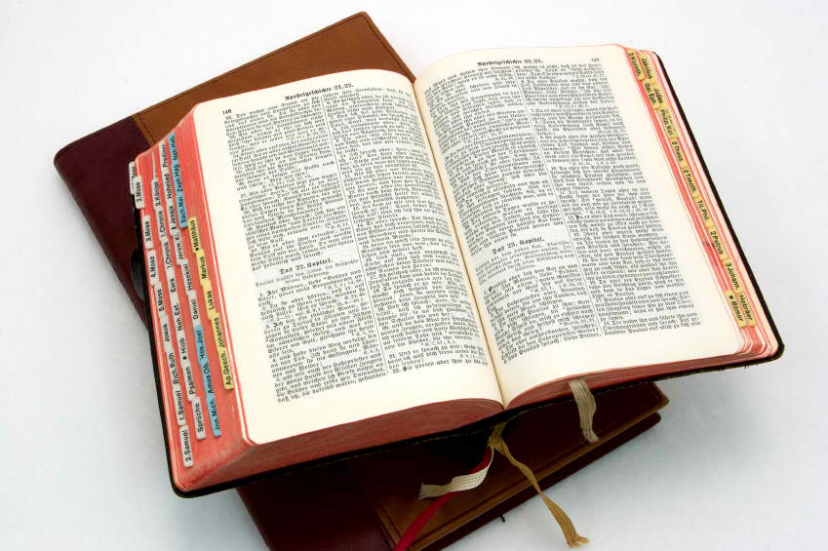
UNTIL NEXT TIME!!!

