Slide 1
Charity Missionary Baptist Church
Wednesday Bible Study
April 3, 2024

Slide 2
Question 1
1. What is your definition of forgiveness?

Slide 3
ANSWER 1 – Part I
“Forgiveness is the wiping out of an offense from memory; it can be affected only by the one affronted. Once eradicated, the offense no longer conditions the relationship between the offender and the one affronted, …

Slide 4
ANSWER 1 – Part II
…and harmony is restored between the two.” John McKinley, associate professor, Talbot School of Theology.

Slide 5
Question 2
2. In which of the scriptures, for this lesson, do you think Jesus gave the formula for forgiveness?

Slide 6
ANSWER 2
Jesus gives the full formula in at least 2 passages of scripture:
REBUKE + CONFESS+ REPENT= FORGIVE is the formula and these are the scriptures where Jesus gave the formula, more than once! Read these:

Slide 7
ANSWER 2
Read these:
MATTHEW 18:15-16 NLT
15 "If another believer sins against you, go privately and point out the offense. If the other person listens and confesses it, you have won that person back.
16 But if you are unsuccessful, take one or two others with you and go back again, so that everything you say may be confirmed by two or three witnesses.

Slide 8
ANSWER 2
LUKE 17:3-5 NLT
3 So watch yourselves!
“If another believer sins, rebuke that person; then if there is repentance, forgive.
4 Even if that person wrongs you seven times a day and each time turns again and asks forgiveness, you must forgive.”
5 The apostles said to the Lord, “Show us how to increase our faith.”

Slide 9
Question 3
What is the first action in the formula for forgiveness?

Slide 10
ANSWER 3
Rebuke. Show them their offense or fault against you.

Slide 11
Question 4
What do you think Jesus means by “rebuke that person” in Luke 17:3?

Slide 12
ANSWER 4
The road to forgiveness should always start with a rebuke. Go to “that person” not others!

Slide 13
Question 5
What does Jesus mean in Matthew 18:15 by “go privately and point out the offense” and why is that process so important?

Slide 14
ANSWER 5 – Part I
Look at the rest of Matthew 18:15 “If the other person listens and confesses it, you have won that person back.” DON’T tell others, tell the one you think hurt you! Minimize the drama!!

Slide 15
ANSWER 5 – Part II
Make sure YOU WANT forgiveness and not the joy and pain of anger and bitterness and your personal movie or tv drama!

Slide 16
Question 6
Have you ever had to rebuke someone, or have you ever been rebuked?

Slide 17
ANSWER 6 – Part I
Yes, I’ve been ‘buked an’ I’ve been scorned, children I’ve been ‘buked an’ I’ve been scorned I’ve been talked about, sho’s you’re born
Dere is trouble all over dis world Children, dere is trouble all over dis world…

Slide 18
ANSWER 6 – Part II
Ain’t gwine to lay my ‘ligion down Children, ain’t gwine to lay my ‘ligion down
HOW ABOUT YOU???

Slide 19
Question 7
What do you think Jesus means in Matthew 18:20 KJV by “where two or three are gathered in my name, there I am in the midst of them” and how is that statement connected to the formula for forgiveness?

Slide 20
ANSWER 7
“This procedure comes from Deut 19:15. Taking “one or two” people with you adds up to “two or three” witnesses. Not eyewitnesses of the sin, but those who can testify as to how the attempt at reconciliation goes.”
And 18:20, “While Christ is present is even the smallest gathering of his people, his point in this context is that heaven is in accord (v.19) with believers who follow his instructions regarding church discipline.” From the ESV Study Bible

Slide 21
ANSWER 7
Jesus is teaching in this misunderstood, misapplied and misused text, that when we bring others in our business or church business we are to use “the rules of Savior” from Matthew Chapter 18, and have two or three believers there using the formula to bring about forgiveness, if possible.

Slide 22
Question 8
After reading 2 Chronicles 6:34-42 and the well-known 2 Chronicles 7:11-14, can you explain how this famous text is connected to the formula for forgiveness?

Slide 23
ANSWER 8
2 Chronicles shows King Solomon’s prayer of dedication for the new temple and in this prayer starting at Verse 24 Solomon asks the Lord to forgive his people for their sins against the Lord, IF they met certain conditions. The Lord was answering King Solomon when He said some of most well known and most often quoted words in the whole Bible..., “if my people, who are called by my name will humble themselves…” is really the answer to a prayer!

Slide 24
BONUS QUESTION
After reading 2 Chronicles 6:34-42 and 2 Chronicles 7:11-14; which option below best describes your understanding of “if my people who are called my name…”
a. the same
b. clearer
c. more confusing
d. BOOM!

Slide 25
BONUS - ANSWER 9
BOOM! God is a prayer answering God!!

Slide 26
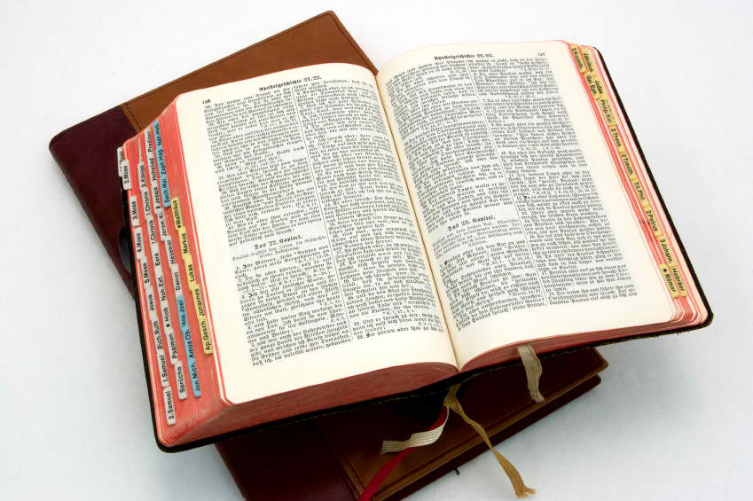
UNTIL NEXT TIME!!!

